Slide 1
Introduction
For this topic we will be focussing on the following:
An Introduction to PHP
Registering for a Server
Output
Using HTML within PHP
Variables
Arithmetic
Selections
Iterations
Arrays
We will now begin to focus on all of the above

Slide 2

An Introduction to PHP
What is PHP?
PHP is also known as Hypertext Preprocessor
It is a scripting language that helps make web pages more interactive by allowing them to do more things than you can do with HTML
An example of a use of PHP is where you may have pages that are password protected – a web page that does not include any scripts would not be able to be password protected
The structure of PHP is similar to other languages such as C, C++, C#, Perl and Java
It is open source software which means that it is free for everybody to install and use on their server
Wikipedia and Moodle use the PHP scripting language
For more information visit:
http://en.wikipedia.org/wiki/PHP

Slide 3

An Introduction to PHP – Output – Introduction
We will be looking at a very simple example of PHP scripting to begin with
This example will allow you to display a Welcome Message within a Web Page
I will show you how to:
Create your Script
Save your Script
Upload your Script to your Server
Run the Script via a Browser
Fix the errors within the Script
You will need to follow the above steps for every PHP script you use for this Unit

Slide 4

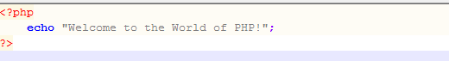
An Introduction to PHP – Output – Creating your Script
To create a PHP Script you will need to use a Text Editor
I am going to use Notepad++
http://portableapps.com/apps/development/notepadpp_portable
For our first PHP example create the following PHP Script:

Slide 5
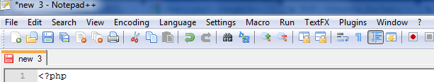
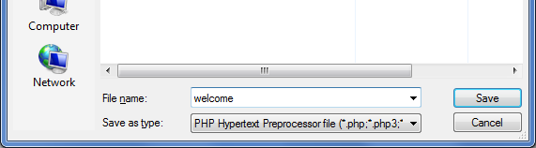
An Introduction to PHP – Output – Saving your Script
Now that you have written your PHP Script you will need to Save it – Click on the Save Icon:
Save your PHP Script using welcome as your filename:
Make sure that you change Save as type to PHP Hypertext Preprocessor file!

Slide 6
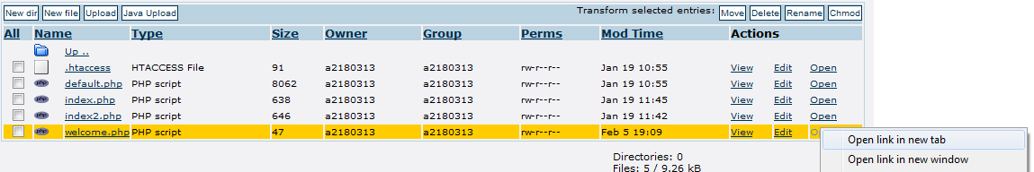
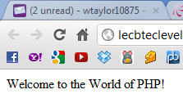
An Introduction to PHP – Output – Running your Script
By this point you should have Uploaded your welcome.php file
In order to Run it and see what it does you will need to Right Click on Open and then on Open link in new tab:
You should then get the following screen which shows your PHP script running in your Browser:

Slide 7
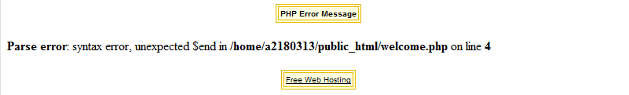
An Introduction to PHP – Output – Fixing Errors
You may or may not get an error like the following once you Run your Script:
If this does happen then you will need to take the following steps:
1 – Look at your .php file in your Text Editor (Notepad++ for example)
2 – Find and correct any mistakes you have made
3 – Save your .php file
4 – Upload your .php file to the Server
5 – Run it in your Browser again to see if it is working correctly
6 – Repeat steps 1 to 5 if needed ☺

Slide 8
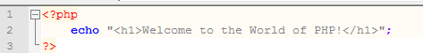
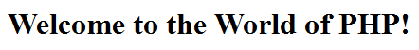
An Introduction to PHP – Using HTML 1
In the previous example (Output) you displayed a very basic Welcome Message using PHP
It is also possible to use HTML Tags within your PHP Script
For example you can use a Heading Tag such as <h1>
Change your welcome.php file so that it matches the following:
Save it using welcomeUsingHTML.php as your filename, upload it and test it and you should get:

Slide 9
An Introduction to PHP – Using HTML 2
You can use any of the other HTML Tags within your PHP Script, for example:
Headings: <h2>, <h3>, <h4>, <h5> and <h6>
Text Formatting: <b>, <i> and <u>
Changing the Font: <font>
Inserting Images: <img src>
Inserting Links: <a href>
Plus others...
If you want to see more HTML Tags and see how they can by used, then please visit here:
http://vzone.virgin.net/sizzling.jalfrezi/iniframe.htm

Slide 10
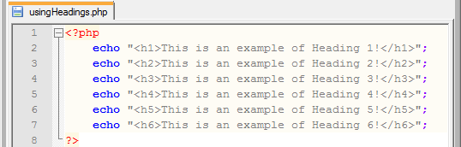
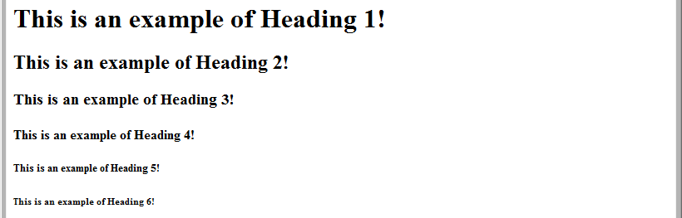
An Introduction to PHP – Using HTML 3
Using Headings:
This will give you:

Slide 11
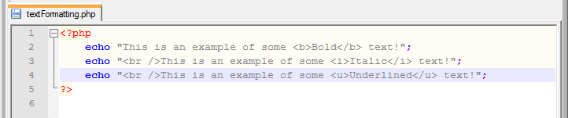
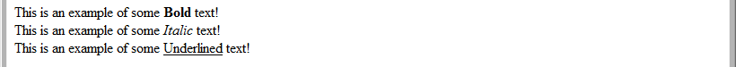
An Introduction to PHP – Using HTML 4
Using Text Formatting:
This will give you:
Please Note:
The <br /> Tag will move your text on to a new line and then display the text that follows the Tag

Slide 12
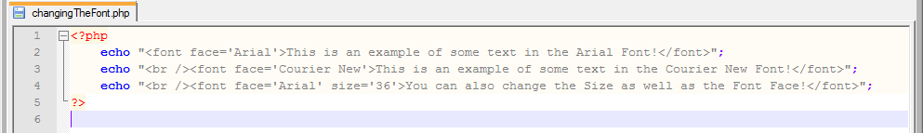
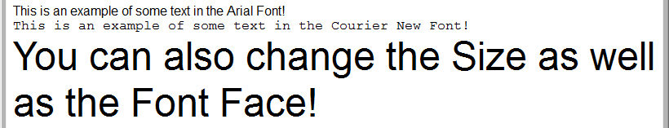
An Introduction to PHP – Using HTML 5
Changing the Font:
This will give you:

Slide 13
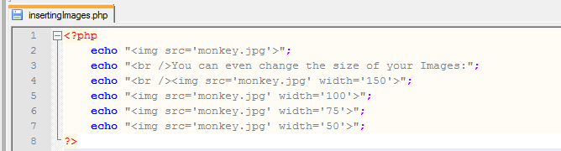
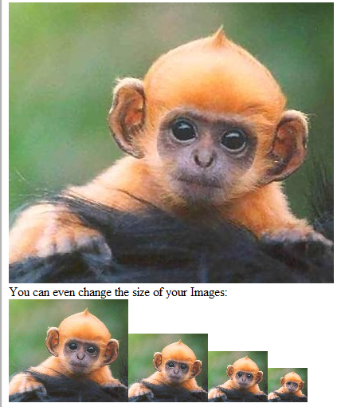
An Introduction to PHP – Using HTML 6
Inserting Images:
This will give you:
Important Note:
You must make sure that you upload your image as well as your .php file!

Slide 14
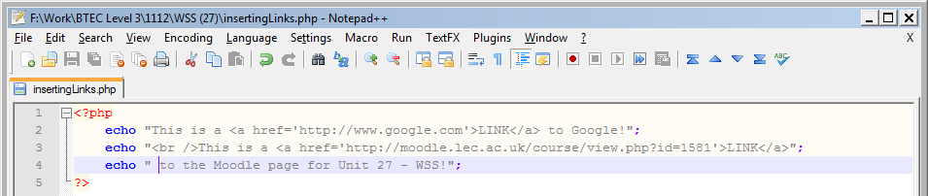
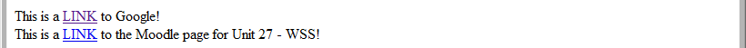
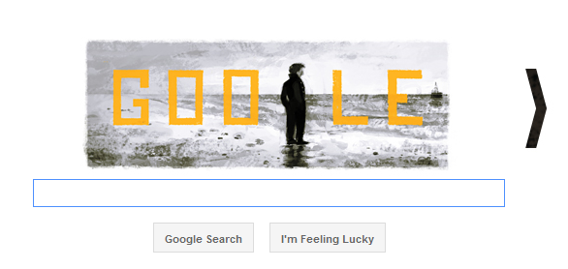
An Introduction to PHP – Using HTML
Inserting Links:
This will give you:

Slide 15
An Introduction to PHP – Using HTML 8
Challenging Exercise:
Use a combination of Headings, Text Formatting, Changing the Font, Inserting Images and Inserting Links to create a PHP file called allAboutMe.php that contains details, an image and a link related to you – Make sure that you Save it, Upload it and Run it in your Browser

Slide 16
An Introduction to PHP – Variables 1
In order to store values in your PHP Script you will need to use variables
In order to create a variable you need to use a $ symbol followed by the name of the variable
For example: If you wanted to store someone’s name you could create a variable called $username
There are rules that you must follow in order to create variables in PHP and they are:
The name must start with a letter or an underscore ( _ )
The name can only contain alpha-numeric characters and underscores (a-z, A-Z, 0-9, and _ )
A variable name should not contain spaces – If the name is more than one word then it should be separated with an underscore ($user_age) or with camel notation ($userAge)

Slide 17
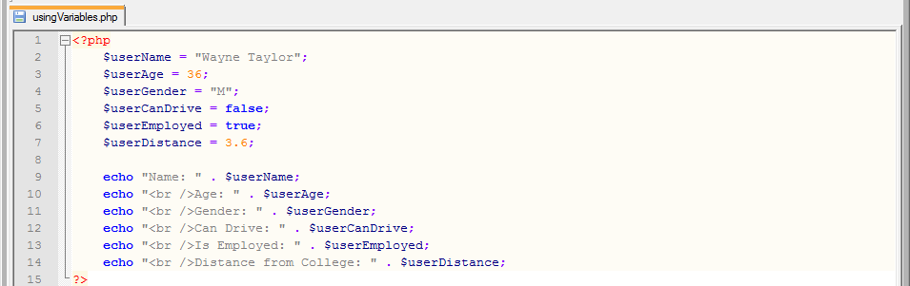
An Introduction to PHP – Variables 2
When creating a variable you will normally store an initial value for the variable
For example: $userName = “Imran Khan";
But you may also create a variable with no initial value
For example: $userName;
Here is an example of a PHP Script that uses a range of variables and different types of data:
When storing text you will need to make sure that you use speech marks on either side of the text
When storing numeric values you do not need to use speech marks

Slide 18
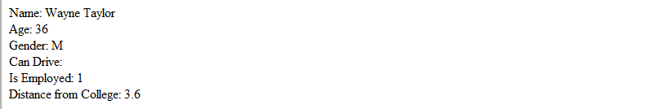
An Introduction to PHP – Variables 3
The previous PHP script will give you the following output in your browser:
Exercise: Try creating a different version of the previous PHP script using data all about you and call it usingVariablesAboutMe.php – Make sure that you save it, upload it and run it in your browser
When using a variable that contains boolean data it will not display a value if you are storing false
But if you store true then it will display the number 1

Slide 19
An Introduction to PHP – Arithmetic 1
There may be times when you are writing PHP scripts when you need to perform calculations with the values stored in your variables
Simple calculations use the following symbols:
+, -, *, / and %
Division Examples:
72 / 10 = 7.2 (Regular Division)
72 % 10 = 2 (Modular/Remainder Division)

Slide 20
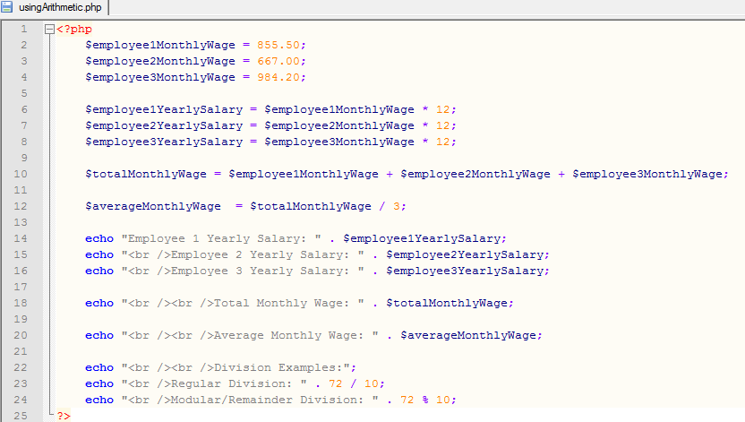
An Introduction to PHP – Arithmetic 2
Here is an example of a PHP script that uses most of arithmetic symbols:

Slide 21
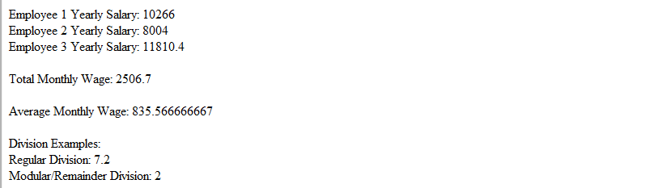
An Introduction to PHP – Arithmetic 3
Which will give you following in your Browser:
Challenging Exercise:
Write a PHP script (called yearOnePoints.php) that stores all of the points you got from the units you completed in year one using variables and use arithmetic to work out the total number of points you got from the year
Each Pass is worth 70 points, Merits are worth 80 and Distinctions are 90 points each

Slide 22
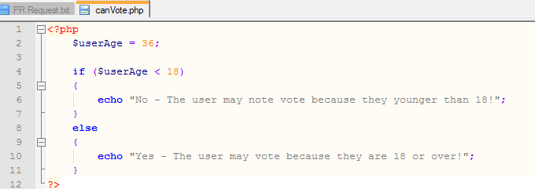
An Introduction to PHP – Selections 1
There may be times when you are using PHP that you want your Script to make a decision based on a comparison – You can use if in PHP to make Selections
For example: You may be writing a Script that determines whether your User is able to vote in the UK or not – Here is an example of a PHP Script called canVote.php:

Slide 23
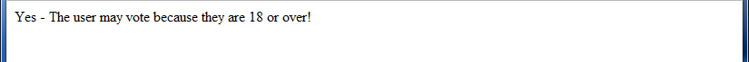
An Introduction to PHP – Selections 2
Once you run canVote.php in your Browser you should get this:
Note that the $userAge variable was given a value of 36 and this meant that the user was old enough
Exercise: Try changing the $userAge variable to 17 and 18 and notice what happens to the output message in your Browser

Slide 24
An Introduction to PHP – Selections 3
The following symbols are used when comparing values:
== means equals
12 == 12 is True and 12 == 13 is False
!= means does not equal
12 != 13 is True and 12 != 12 is False
< means less than
12 < 13 is True and 13 < 12 is False
> means greater than
13 > 12 is True and 12 > 13 is False
<= means less than or equal to
12 <= 13 is True, 12 <= 12 is True and 12 <= 11 is False
>= means greater than or equal to
13 >= 12 is True, 13 >= 13 is True and 13 >= 14 is False

Slide 25
An Introduction to PHP – Selections 4
There may be times when you want to include more than one comparison in your Selection
In other words you may want to check more than one thing at a time
You can use the following symbols to check more than one comparison at a time:
&& means And (Also known as Double Ampersand)
This allows you to check to see if all of the comparisons are True or not
A == A && B == B is True (Both Comparisons are True)
A == A && B == A is False (Left Comparison is True and Right Comparison is False)
A == B && B == B is False (Left Comparison is False and Right Comparison is True)
A == B && B == A is False (Both Comparisons are False)
|| means Or (This is the symbol next to the Z key and is also known as Double Pipe)
This allows you to check to see if any of the Comparisons are True or not
This works in a similar way to the && but only one Comparison needs to be True and not all of them in order for the result to be True

Slide 26
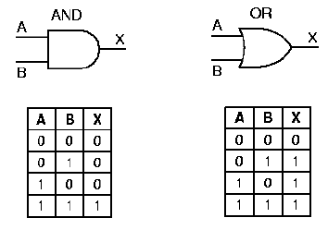
An Introduction to PHP – Selections 5
The && and the || work in the same way as the AND and OR Logic Gates:

Slide 27
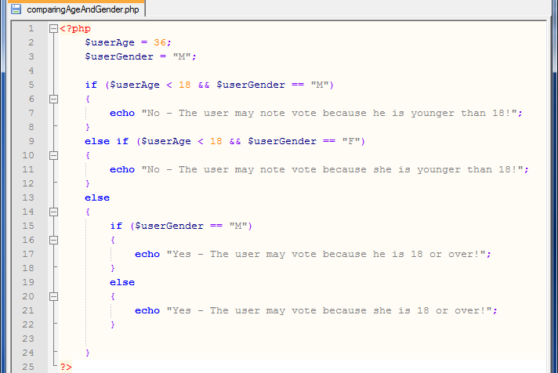
An Introduction to PHP – Selections 6
Here is a Script called comparingAgeAndGender.php that uses a combination of many of the symbols that we have talked about:

Slide 28
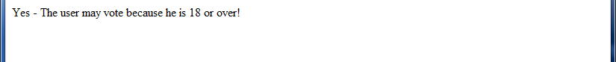
An Introduction to PHP – Selections 7
You should get the following when running your Script:
Exercises:
Try changing $userGender to F and notice what happens
Try changing $userAge to 17 and $userGender to M and notice what happens
Try changing $userGender to F and notice what happens
Challenging Exercise:
Rewrite the Program (the one using C#) that you created in Unit 16 for assignment 3 during the first year, this time you will need to use a PHP Script and call it comparingUsers.php
This was the program where you had to compare data for 2 Users – You had to compare their Ages, Genders, Whether they could Drive and the Distance that they live away from the College Campus (Note: You will only need to use Variables and Selections to create this Script and you do not need to use Objects such as Text Boxes, Buttons etc.)

Slide 29
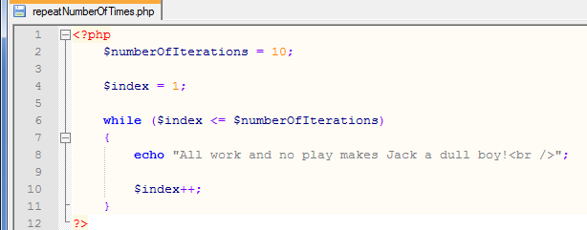
An Introduction to PHP – Iterations 1
There may be times when writing PHP Scripts where you want to repeat lines of code – To do this you would use a Loop which is also known as an Iteration
In PHP you can use While Loops to Iterate your code
Here is an example of a PHP Script called repeatNumberOfTimes.php that repeats a sentence 10 times:

Slide 30
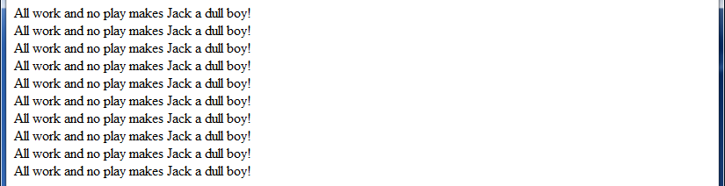
An Introduction to PHP – Iterations 2
You should get the following when you run your Script:
Exercises:
Try increasing the $numberOfIterations variable to something like 100 and notice what happens
Try decreasing the $numberOfIterations variable to 5 and notice what happens

Slide 31
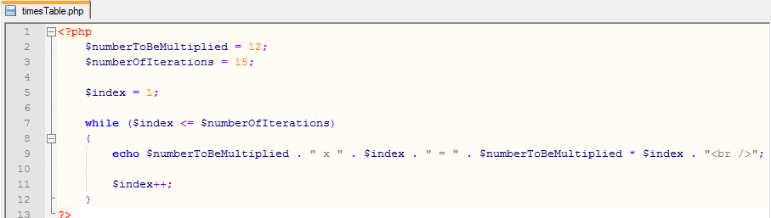
An Introduction to PHP – Iterations 3
Here is an example of a PHP Script called timesTable.php that calculates and displays the Times Table of a number specified in the Script:

Slide 32
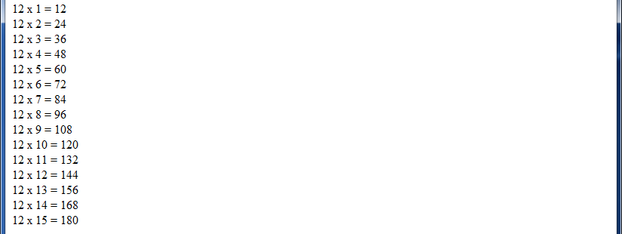
An Introduction to PHP – Iterations 4
You should get the following when you run your Script:
Exercises:
Try increasing the $numberOfIterations variable to something like 100 and notice what happens
Try decreasing the $numberOfIterations variable to 5 and notice what happens
Try changing the $numberToBeMultiplied variable and notice what happens

Slide 33
An Introduction to PHP – Arrays 1
What is an Array?
A variable is a storage area holding a number or text and a variable will only hold one value
An array can store multiple values
If you have a list of items (a list of people’s names for example) storing the names using variables could look like this:
$name1="David";
$names2="Freda";
$names3="Hajra";
However, what if you want to loop through the names and find a specific one? And what if we had not 3 names but 300?
The best solution here is to use an array!

Slide 34
An Introduction to PHP – Arrays 2
An array can hold all of your values under a single name
Each element in the array has its own index so that it can be easily accessed (usually the first item in the index has a value of 0 (zero))
In PHP, there are three kind of arrays:
Numeric Array - An array with a numeric index
Associative Array - An array where each ID key is associated with a value
Multidimensional Array - An array containing one or more arrays
We will be looking at Numeric Arrays and Associative Arrays during this Presentation but you may wish to research Multidimensional Arrays

Slide 35
An Introduction to PHP – Arrays 3
Numeric Arrays
Numeric Arrays store values along with a numeric index
There are 2 ways to create a Numeric Array
$names=array("David", "Freda", "Hajra"); is one way
$names[0]="David";
$names[1]="Freda";
$names[2]="Hajra"; is another way

Slide 36
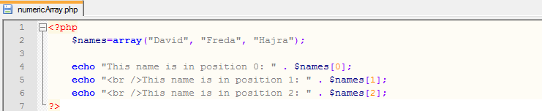
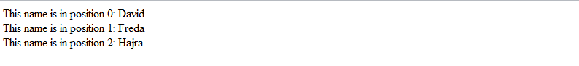
An Introduction to PHP – Arrays 4
Here is an example of a PHP Script called numericArray.php that uses the first method of creating a Numeric Array:
You should get the following when you run your Script:
Exercise: Add 4 more names to the Array and display them

Slide 37
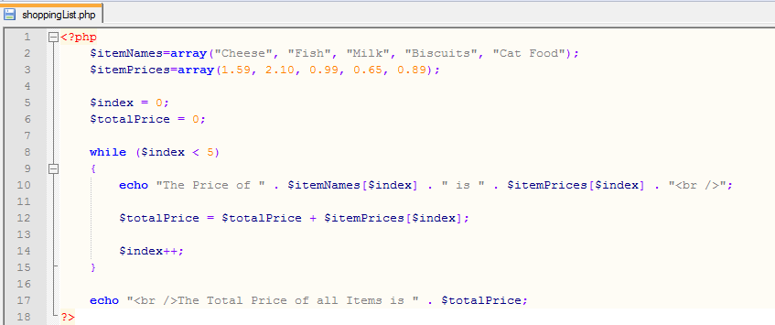
An Introduction to PHP – Arrays 5
Here is another example of a PHP Script called shoppingList.php that uses 2 Numeric Arrays (1 to store the Names of the Items and 1 to store the Prices) and it uses a Loop to calculate the Total Price of all Items purchased in a Supermarket:

Slide 38
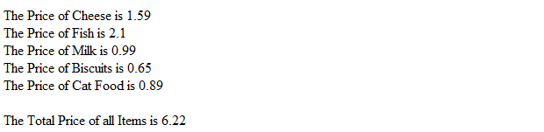
An Introduction to PHP – Arrays 6
You should get the following when you run your Script:
Exercise:
Add 3 more Products complete with Names and Prices and change the loop so it calculates the total price of all 8 items
Challenging Exercise:
Add 2 more Numeric Arrays (1 to store the Product Brand and 1 to store the Product Weight), include appropriate values within the Arrays and display the values within the loop
Example: For your Cat Food you could display The Price of Whiskas Cat Food is 0.89 and it weighs 400g

Slide 39
An Introduction to PHP – Arrays 7
Associative Arrays
When using an associative array each ID key is associated with a value
With associative arrays we can use the values as keys and assign values to them
There are 2 ways to create an Associative Array:
$ages = array("David"=>32, "Mavis"=>17, "Mandeep"=>22); is one way
$ages['David'] = 32;
$ages['Mavis'] = 17;
$ages['Mandeep'] = 22; is another way

Slide 40
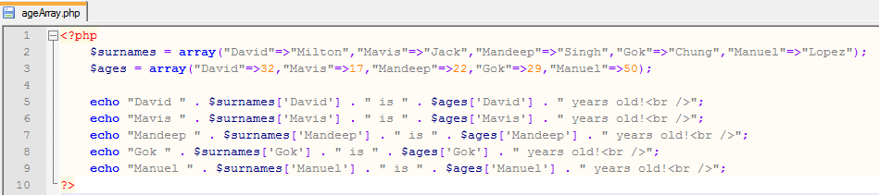
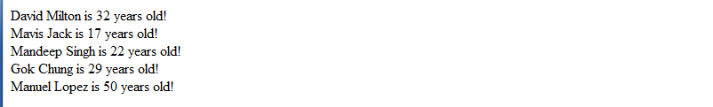
An Introduction to PHP – Arrays 8
The following PHP Script is called ageArray.php and it uses 2 Associative Arrays, 1 Array is used to store the Surnames of 5 people and the other Array is used to store the Ages:
This should give you the following when you run your Script:

Slide 41
An Introduction to PHP – Arrays 9
Exercises:
Change the Names, Surnames and Ages in the Script so that the details belong to you and 4 of your friends/family members
Add 3 more of your friends/family members to the Script
Challenging Exercise:
Add another Associative Array called $hobbies and use it to store the favourite Hobbies of your 8 people and ensure that you display the Hobbies in your output

Slide 42
Summary
In this part of the lab we looked at all of the following:
An Introduction to PHP
Registering for a Server
Output
Using HTML within PHP
Variables
Arithmetic
Selections
Iterations
Arrays

